Slide 1



3D Reconstruction
11.17.2017
Xiongming Dai
Produce 1
Maintain 2
-CM
d
0
-CR
d
-CM
0
d+1

Slide 2
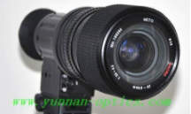
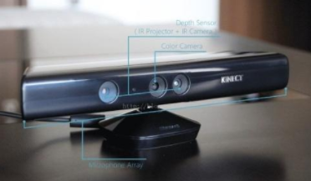
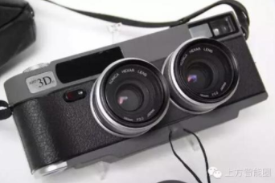
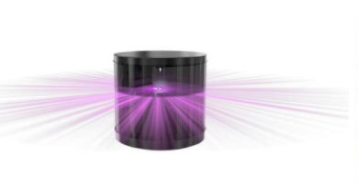
classification
(different method for different sensor )
monocular sensor RGB-D sensor
binocular camera
laser radar

Slide 3
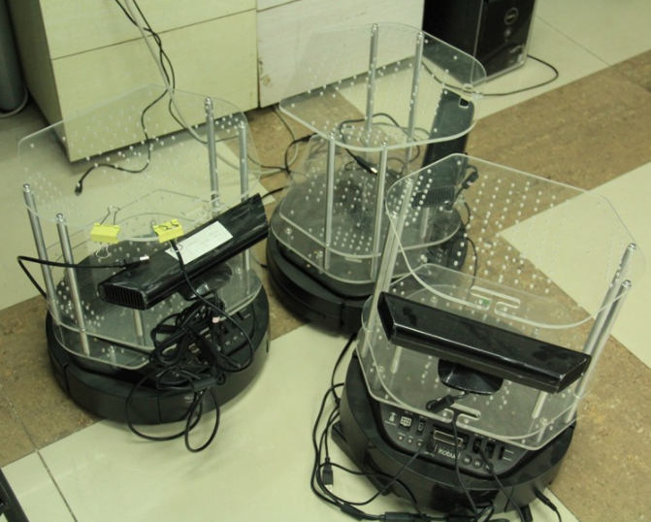
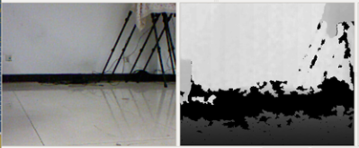
RGB-D sensor
Programming environment:
  OpenCV (Ubuntu 14.04)
  PCL(Point Cloud Library)
Hardware:
  Robot with RGB-D sensor.

Slide 4
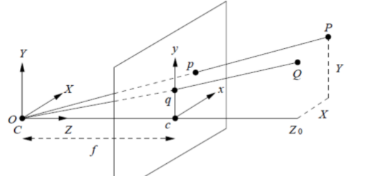
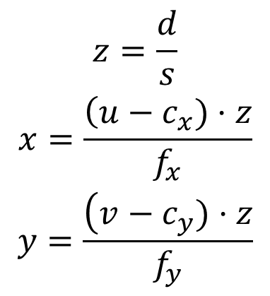
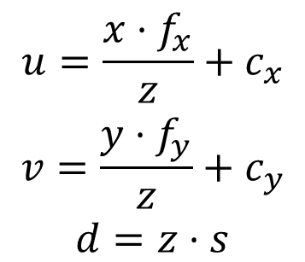
2D to 3D
a point in 3D:
  6 Parameters: r,g,b,x,y,z
P(x,y,z) in 3D space:
(u,v,d) pixel coordinates on image. plane
fx,fy are the focal length on the axis.
cx,cy are the center of the camera.
s is the scaling factor.

Slide 5
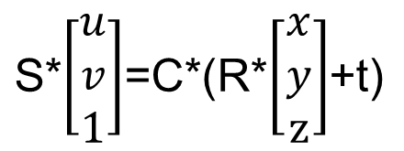
Matrix description
R,t : Camera's pose. R:Rotation Matrix, t:Translation Matrix.
C:Internal Matrix. s:1000 (mm). the scale of the data in the depth with the actural distance.

Slide 6
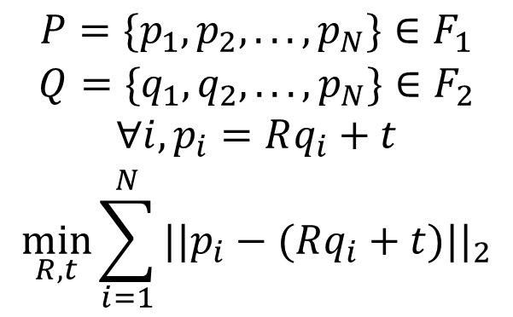
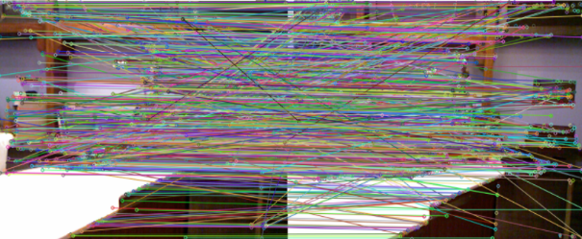
Image Registration
If we have two frames F1,F2, and the associated features :
Reference: 1987 PAMI
ICP:Least-squares fitting of two 3-D point sets。

Slide 7
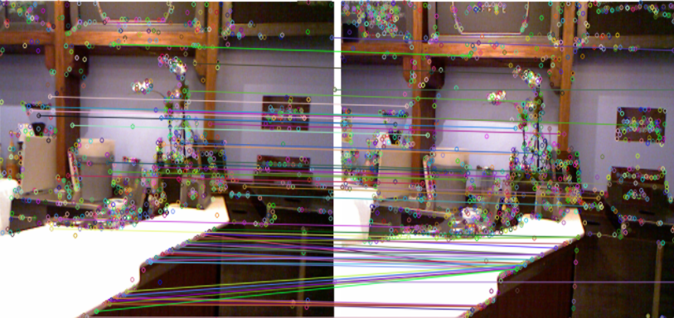
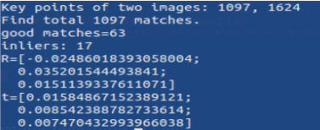
Registration
good match:
Ransac+PnP:input:Object Points and 2D pixel point on Image plane,output：R,t.

Slide 8
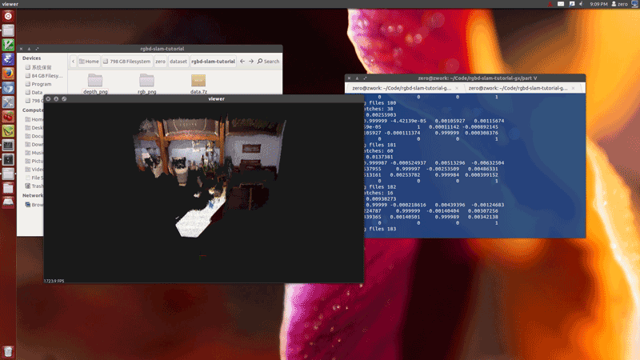
Point Cloud Registration Result

Slide 9

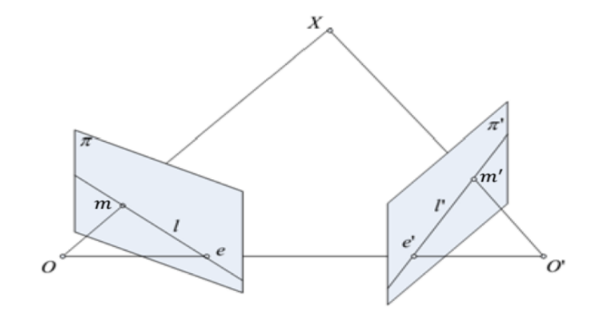
Monocular sensor
kernel moduel:

